Slide 1


Slide 2
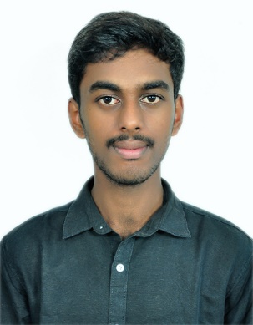
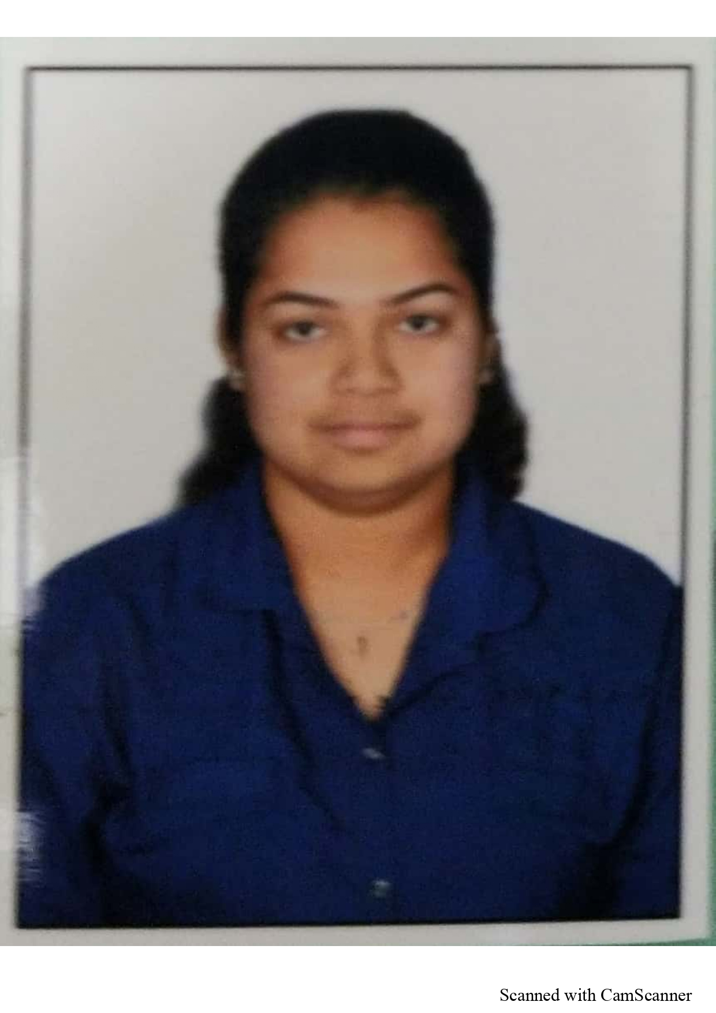
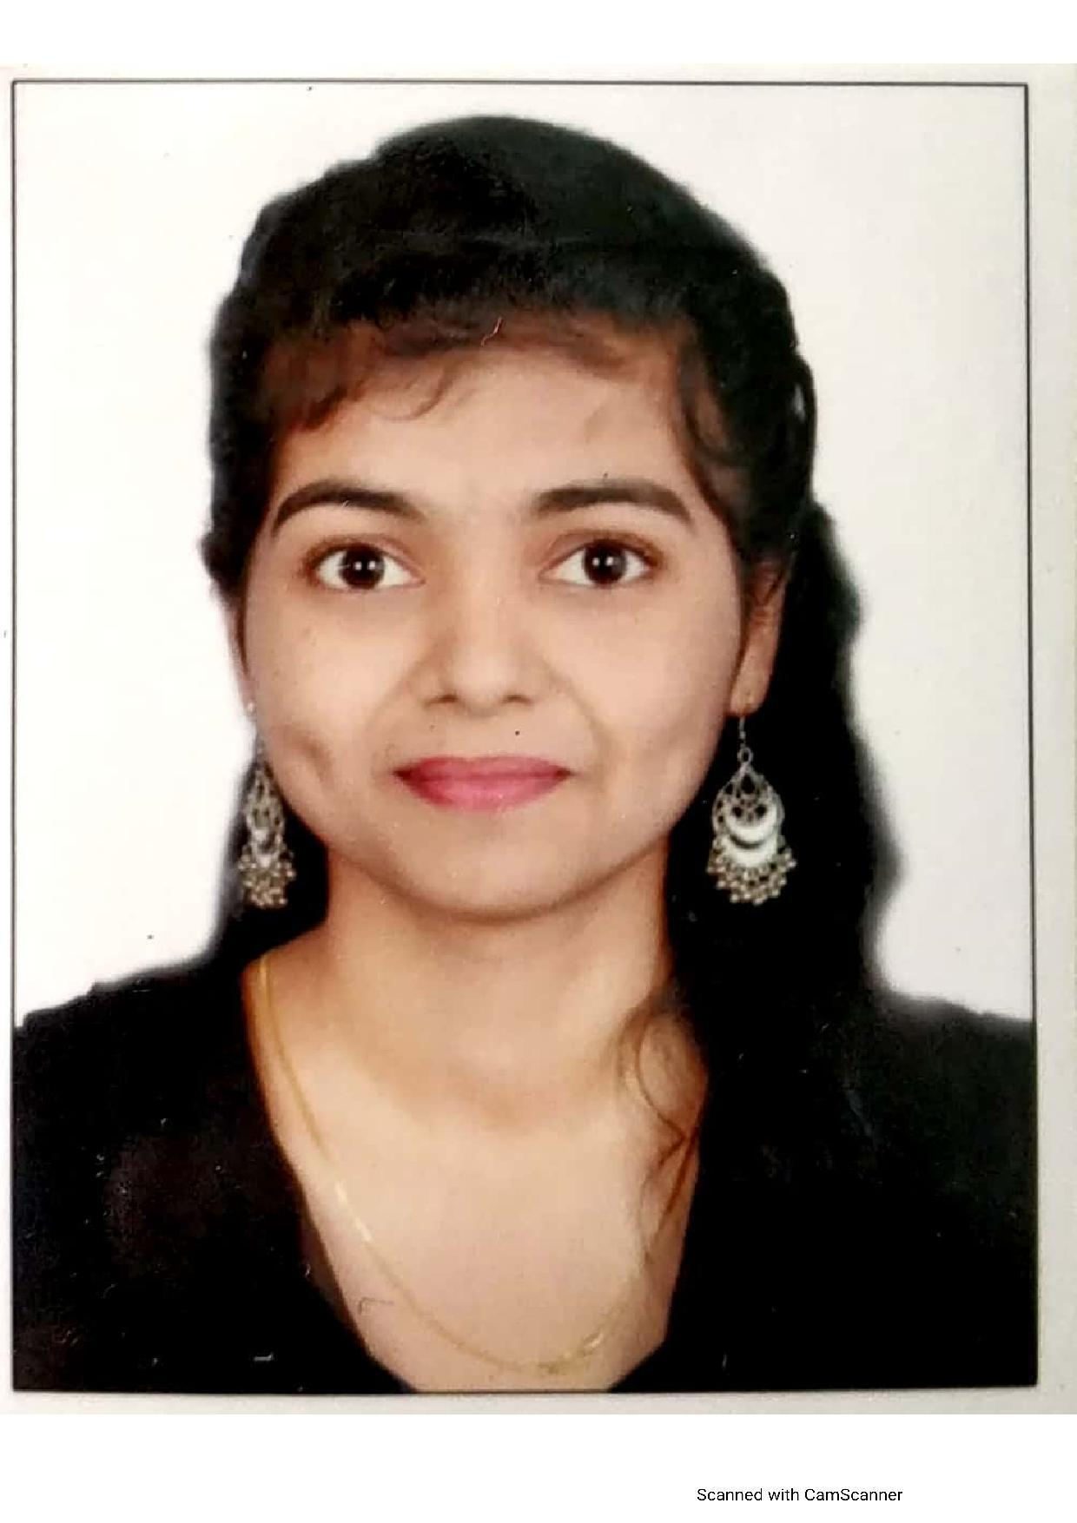
Project Highlights
Project Name : Simple Chat Cord Application
Team Size : 3
BU Mentor Name : Raghavendra C S, Pradeep Tunga, Neha Bandi and Saurabh Mukadam
Team Members Details :
Intern Name – Chethan G C
PS# 99002457
GENESIS Track Code - 2009BLRICP01
Education Details – B.Tech CS
Professional Skills - Problem Solver (Intermediate), Team Player
Intern Name – Akshata C Shet
PS# 99002465
GENESIS Track Code - 2009BLRICP01
Education Details - BE- ECE
Professional Skills - Team player, Quick learner,
Punctual
Intern Name – Dhanashree Santosh Vinherkar
PS# 99002522
GENESIS Track Code - 2009BLRICP01
Education Details – B.E ETC
Professional Skills – Team Player, Mentoring

Slide 3
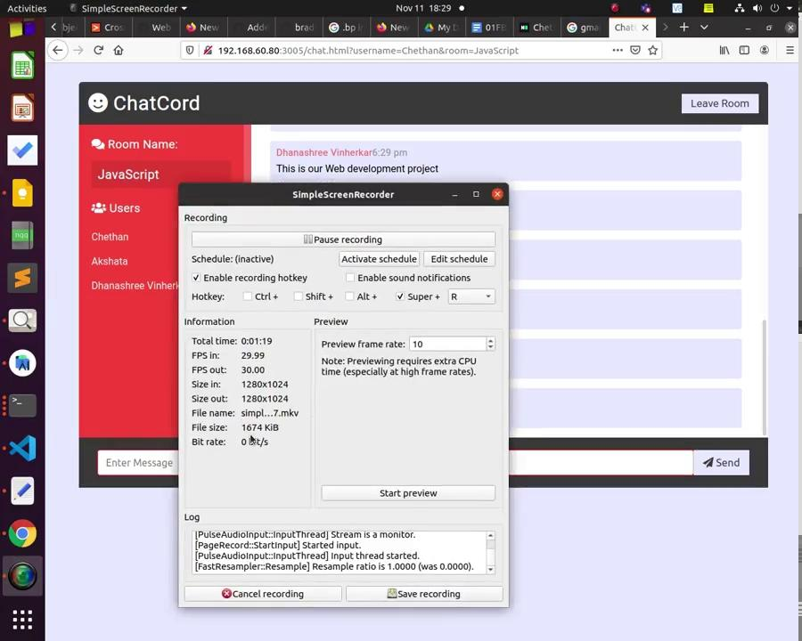
Project Video Snippet - Client 1
https://drive.google.com/drive/u/0/folders/10K4lF_2kPEndybuzpmGaGnnPMQyY-0Ct

Slide 4
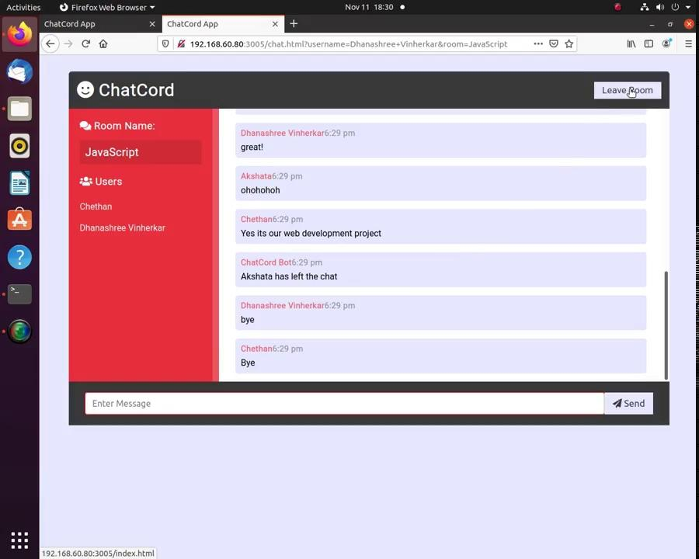
Project Video Snippet -Client 2
https://drive.google.com/drive/u/0/folders/10K4lF_2kPEndybuzpmGaGnnPMQyY-0Ct

Slide 5
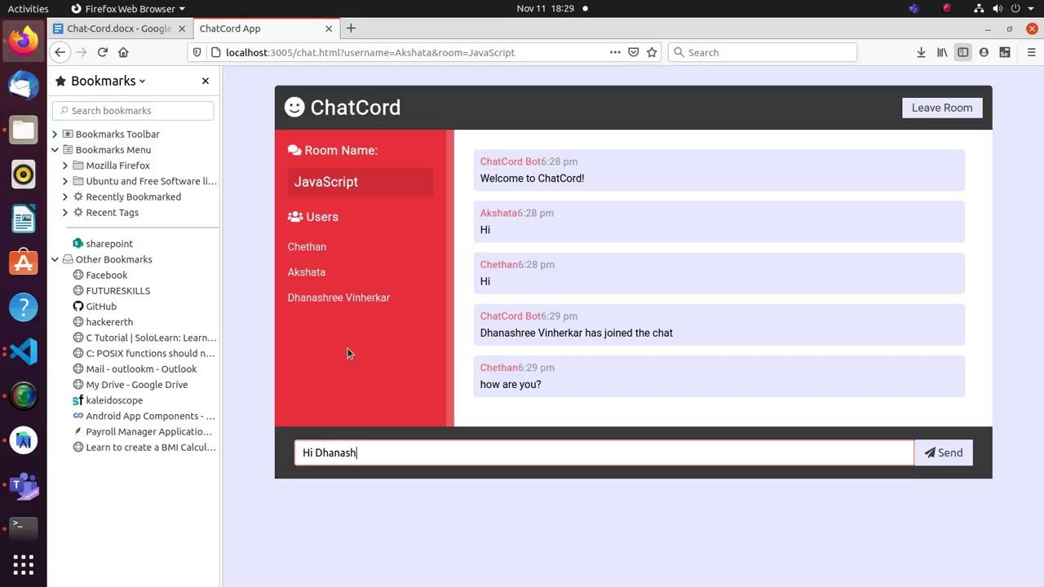
Project Video Snippet -Server
https://drive.google.com/drive/u/0/folders/10K4lF_2kPEndybuzpmGaGnnPMQyY-0Ct

Slide 6
Future development that can be implemented further
Extending this chat-cord for all users.
Inter-Room communication enabling.
Chatting can be made available for the authorized users only.
Chatting server can be hosted to the internet.

Slide 7

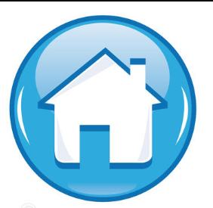
Thank You !

